Slide 2
Prayer and Announcements
Worship and small group gatherings
Study available on our church website
www.faithprinceton.org
Email questions and comments to
pastor@faithprinceton.org

Slide 3
Absence of Copyright
This slideshow contains photos, diagrams, and information, some of which were attained through internet searches of public websites. The author of this presentation does not own the copyright on this information, so this slideshow is for personal use only—not for sale or profit. Please utilize it to seek the Lord and grow in your knowledge of His Word and ways.

Slide 5
1:12-16 SYMBOLISM IN REVELATION
¹² seven golden lampstands = churches; light-bearers
¹³ one like a son of man = Jesus; sometimes angels
clothed in a robe reaching to the feet, and girded across His chest with a golden sash = royalty; priesthood
¹⁴ His head and His hair were white like white wool, like snow = purity; wisdom of the ages
His eyes were like a flame of fire = righteous judgment
¹⁵ His feet were like burnished bronze, when it has been made to glow in a furnace = steady, solid foundation
His voice was like the sound of many waters = majesty; authority; sovereignty

Slide 6
1:12-16 SYBOLISM IN REVELATION
¹⁶ In His right hand He held seven stars = messengers
out of His mouth came a sharp two-edged sword = the Word of God
His face was like the sun shining in its strength = strength; brilliance; glory; truth

Slide 7
1:17-20
¹⁷ When I saw Him, I fell at His feet like a dead man. And He placed His right hand on me, saying, “Do not be afraid; I am the first and the last, ¹⁸ and the living One; and I was dead, and behold, I am alive forevermore, and I have the keys of death and of Hades. ¹⁹ Therefore write the things which you have seen, and the things which are, and the things which will take place after these things. ²⁰ As for the mystery of the seven stars which you saw in My right hand, and the seven golden lampstands: the seven stars are the angels of the seven churches, and the seven lampstands are the seven churches.

Slide 8
1:17-20
¹⁷ I fell at His feet like a dead man…. “Do not be afraid…
common Biblical admonition (366 times?)
John = “the disciple whom Jesus loved”
¹⁸ the living One; and I was dead, and behold, I am alive forevermore
Living One became dead… behold… the dead one alive
and I have the keys of death and of Hades.
Keys = symbol of power and authority and control
Notes:
Placed His right hand on me = His powerful hand brought comfort and consolation and strength.
“Do not fear, for I am with you; Do not anxiously look about you, for I am Your God. I will strengthen you, surely I will help you. Surely I will uphold you with My righteous right hand.” Isaiah 41:10

Slide 9
1:17-20
²⁰ As for the mystery of the seven stars which you saw in My right hand, and the seven golden lampstands: the seven stars are the angels of the seven churches, and the seven lampstands are the seven churches.
Angels = ἄγγελοι (used 176 times in NT)
Definition: a messenger, delegate, angel Usage: a messenger, generally a (supernatural) messenger from God, an angel, conveying news or behests from God to men.
Lampstands = Hebrew word would be menorah
Churches are to be “light bearers”
Notes:
32 ággelos – properly, a messenger or delegate – either human (Mt 11:10; Lk 7:24, 9:52; Gal 4:14; Js 2:25) or heavenly (a celestial angel); someone sent (by God) to proclaim His message.
32 (ággelos) is used 176 times in the NT (usually of heavenly angels), but only the context determines whether a human or celestial messenger is intended.
For example, 32 (ággelos) in Rev 1:20 can refer to heavenly angels or key leaders (perhaps pastors) of the seven churches.
[32 (ággelos) can refer to "a human messenger" (cf. John the Baptist, Mt 11:10, quoting Mal 3:1; see also Lk 7:24, 9:52).
32 /ággelos (plural, angeloi) refers to heavenly angels over 150 times in the NT, i.e. spiritual beings created by God to serve His plan.
In Rev 2, 3, "angels" seems to refer to heavenly angels that serve God in conjunction with these seven local churches.
(Rev 2:1) – "Probably 'the angels of the churches' (Rev 1:20, 2:1, etc.) – i.e. really angels, and not pastors" (DNTT, Vol 1, 103).]

Slide 10
Letters to the Seven Churches
Revelation 2-3

Slide 11
1:4
the seven churches that are in Asia:

Slide 12
Structure of the Letters
Introduction/Description of Jesus
Praise/Commendation
Condemnation/Rebuke
Charge/Challenge
Promise/Consequences
Notes:
“He who has ears to hear, let him hear what the Spirit says to the churches!”

Slide 13
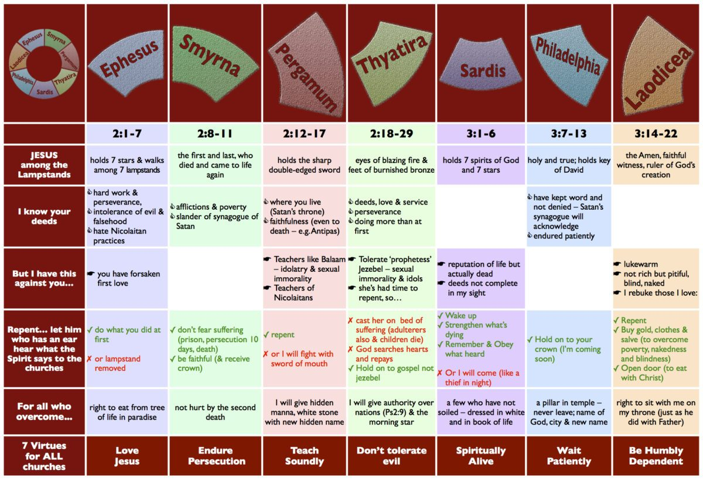
Notes:
Chart from: https://www.markmeynell.net/2011/09/13/911-through-the-lens-of-revelation/

Slide 14
Ways to interpret the Letters
Four possible audiences addressed in Revelation 2-3:
The literal churches
Saints “who have an ear to hear”
Seven Church types
Seven Church ages
Notes:
From:
Notes: https://truthnet.org/Christianity/revelation/Revelation2/
There are four audiences addressed in the book of Revelation:
1. The literal churches, 2. Saints “who have an ear”, 3. Seven Church types, 4. Seven Church ages
1. The literal churches
The first audience addressed in these letters is the literal church. These were literal churches with literal problems. Jesus in his comments first acknowledges the positive aspects (commendation) for each church. Except for the church of Laodicea, they had no commendation. Jesus also points out, where the churches lacked and their sin (condemnation). He warns them, what would follow, if they fail to correct the problem. The churches of Smyrna and Philadelphia received no condemnation, but were consoled for their suffering and weakness. The resurrected Jesus tells the failing churches what they need to do to correct their course (consultation). Jesus then promises the person who “Overcomes” an aspect of the life to come. He challenges the believer, to succeed, to “Overcome”, and achieve the challenge before them.
2. The saints “He who has an ear”
In addition to the physical churches, the letter also applies to every individual member of the church, especially those who have “Spiritual ears”. Jesus specifically addresses those who have an ear. The ear referred to here is not a physical ear, but a spiritual ear. Jesus is talking to the spiritual hearing, those who have a spiritual ear, to hear what the Spirit is saying to the churches. The contents of the letter as well as the comments are not limited to the “Seven Churches”, but the whole church.
The seven churches are merely models of what applies to the whole of Christianity. The church is made up of various types of believers, each like these churches dealing with issues. Some saints now suffer, some are rich, others have compromised their walk and their beliefs. To us, who have “Spiritual” ears, Jesus addresses this letter. Jesus holds out the promise, the challenge to the “Overcomer”.
3. Seven Church Types
Of the seven churches, no two are alike. Some of the churches have aspects of the other churches, but they deal with them in a different ways. Both Ephesus and Pergamum had Nicolaitans, one rejected them the other tolerated them. This variety in church types demonstrates an aspect seen from the founding of churches in individual cities, not every church is alike. Some churches are more obedient then others some thrive in the midst of persecution, others crumble with an abundance of wealth and power.
These seven church models are seven church-types; here Jesus gives the secret for a successful church. The letter to the seven churches is also a letter to seven types of churches. Churches today are faced with the same problems these first century churches faced. Jesus is telling the church how to deal with its problems.
Today there are huge church buildings and large congregations, filled with divisions over gay rights and abortion, what would Jesus’ position be on these issues? We can look at the model of Thyatira to find the answer. What about the suffering Christians in places where Christianity is persecuted by governments, like North Korea, Saudi Arabia and Iran? The church at Smyrna models the persecuted church, the letter is for them. If you were in a persecuted church, the message to Smyrna would be a message to your church.
4. The Seven Church Ages In chapter one, we see Jesus in the midst of “Seven Lampstands”. From Revelation 1:21, we learn, the seven lampstands represent the seven churches addressed in chapters 2 and 3. They represent the complete church. The progress of church history has a direct correlation to the events following the seven churches of Revelation chapters 2 and 3.
Starting with the Ephesus, the church founded by the Apostle Paul and administered by the Apostle John to the church of Laodicea, the wealthy lukewarm church, the history of the church is prophetically foretold. Jesus gives a “Prophetic foreshadowing” in the seven churches. From the churches founded by the apostles to the end of the age, Christ has a message for each church age imbedded in the message to the seven churches.
Following John, the last apostle, the Church underwent a period of persecution, until the time of Constantine, where the Roman Emperor himself professed to be a Christian. Christianity became popular within the Roman Empire. Constantine made allowances for pagan rites and customs. The correspondence between history and the letters to the seven churches, demonstrates their prophetic nature, foretelling the history and progression of church until the end of the age. This correspondence can be seen as the prophetic foreshadowing of the seven church ages.

Slide 15
An example of the “Seven Church Ages” interpretation
Notes:
From:
Chart: http://lafayettefirstumc.org/2015/05/18/seven-churches-of-revelation-sermon-series/
Notes: https://truthnet.org/Christianity/revelation/Revelation2/
There are four audiences addressed in the book of Revelation, the literal churches, saints who have an ear, seven church types and seven church ages.
1. The literal churches, 2. Saints, 3. Seven Church types, 4. Seven Church ages
1. The literal churches
The first audience addressed in these letters is the literal church. These were literal churches with literal problems. Jesus in his comments first acknowledges the positive aspects (commendation) for each church. Except for the church of Laodicea, they had no commendation. Jesus also points out, where the churches lacked and their sin (condemnation). He warns them, what would follow, if they fail to correct the problem. The churches of Smyrna and Philadelphia received no condemnation, but were consoled for their suffering and weakness. The resurrected Jesus tells the failing churches what they need to do to correct their course (consultation). Jesus then promises the person who “Overcomes” an aspect of the life to come. He challenges the believer, to succeed, to “Overcome”, and achieve the challenge before them.
2. The saints “He who has an ear”
In addition to the physical churches, the letter also applies to every individual member of the church, especially those who have “Spiritual ears”. Jesus specifically addresses those who have an ear. The ear referred to here is not a physical ear, but a spiritual ear. Jesus is talking to the spiritual hearing, those who have a spiritual ear, to hear what the Spirit is saying to the churches. The contents of the letter as well as the comments are not limited to the “Seven Churches”, but the whole church.
The seven churches are merely models of what applies to the whole of Christianity. The church is made up of various types of believers, each like these churches dealing with issues. Some saints now suffer, some are rich, others have compromised their walk and their beliefs. To us, who have “Spiritual” ears, Jesus addresses this letter. Jesus holds out the promise, the challenge to the “Overcomer”.
3. Seven Church Types
Of the seven churches, no two are alike. Some of the churches have aspects of the other churches, but they deal with them in a different ways. Both Ephesus and Pergamum had Nicolaitans, one rejected them the other tolerated them. This variety in church types demonstrates an aspect seen from the founding of churches in individual cities, not every church is alike. Some churches are more obedient then others some thrive in the midst of persecution, others crumble with an abundance of wealth and power.
These seven church models are seven church-types; here Jesus gives the secret for a successful church. The letter to the seven churches is also a letter to seven types of churches. Churches today are faced with the same problems these first century churches faced. Jesus is telling the church how to deal with its problems.
Today there are huge church buildings and large congregations, filled with divisions over gay rights and abortion, what would Jesus’ position be on these issues? We can look at the model of Thyatira to find the answer. What about the suffering Christians in places where Christianity is persecuted by governments, like North Korea, Saudi Arabia and Iran? The church at Smyrna models the persecuted church, the letter is for them. If you were in a persecuted church, the message to Smyrna would be a message to your church.
4. The Seven Church Ages In chapter one, we see Jesus in the midst of “Seven Lampstands”. From Revelation 1:21, we learn, the seven lampstands represent the seven churches addressed in chapters 2 and 3. They represent the complete church. The progress of church history has a direct correlation to the events following the seven churches of Revelation chapters 2 and 3.
Starting with the Ephesus, the church founded by the Apostle Paul and administered by the Apostle John to the church of Laodicea, the wealthy lukewarm church, the history of the church is prophetically foretold. Jesus gives a “Prophetic foreshadowing” in the seven churches. From the churches founded by the apostles to the end of the age, Christ has a message for each church age imbedded in the message to the seven churches.
Following John, the last apostle, the Church underwent a period of persecution, until the time of Constantine, where the Roman Emperor himself professed to be a Christian. Christianity became popular within the Roman Empire. Constantine made allowances for pagan rites and customs. The correspondence between history and the letters to the seven churches, demonstrates their prophetic nature, foretelling the history and progression of church until the end of the age. This correspondence can be seen as the prophetic foreshadowing of the seven church ages.

Slide 16
Ephesus – Revelation 2:1-7
Notes:
EPHESIANS 1:15-21
For this reason I too, having heard of the faith in the Lord Jesus which exists among you and your love for all the saints, do not cease giving thanks for you, while making mention of you in my prayers; that the God of our Lord Jesus Christ, the Father of glory, may give to you a spirit of wisdom and of revelation in the knowledge of Him. I pray that the eyes of your heart may be enlightened, so that you will know what is the hope of His calling, what are the riches of the glory of His inheritance in the saints, and what is the surpassing greatness of His power toward us who believe. These are in accordance with the working of the strength of His might which He brought about in Christ, when He raised Him from the dead and seated Him at His right hand in the heavenly places, far above all rule and authority and power and dominion, and every name that is named, not only in this age but also in the one to come. And He put all things in subjection under His feet, and gave Him as head over all things to the church, which is His body, the fullness of Him who fills all in all.
Ephesians 1:15‭-‬23 NASB
https://bible.com/bible/100/eph.1.15-23.NASB

Slide 17
Ephesus – Revelation 2:1-7
¹ “To the angel of the church in Ephesus write:
The One who holds the seven stars in His right hand, the One who walks among the seven golden lampstands, says this:
² ‘I know your deeds and your toil and perseverance, and that you cannot tolerate evil men, and you put to the test those who call themselves apostles, and they are not, and you found them to be false; ³ and you have perseverance and have endured for My name’s sake, and have not grown weary. ⁴ But I have this against you, that you have left your first love. ⁵ Therefore remember from where you have fallen, and repent and do the deeds you did at first; or else I am coming to you and will remove your lampstand out of its place—unless you repent. ⁶ Yet this you do have, that you hate the deeds of the Nicolaitans, which I also hate. ⁷ He who has an ear, let him hear what the Spirit says to the churches. To him who overcomes, I will grant to eat of the tree of life which is in the Paradise of God.’
Notes:
EPHESIANS 1:15-21
For this reason I too, having heard of the faith in the Lord Jesus which exists among you and your love for all the saints, do not cease giving thanks for you, while making mention of you in my prayers; that the God of our Lord Jesus Christ, the Father of glory, may give to you a spirit of wisdom and of revelation in the knowledge of Him. I pray that the eyes of your heart may be enlightened, so that you will know what is the hope of His calling, what are the riches of the glory of His inheritance in the saints, and what is the surpassing greatness of His power toward us who believe. These are in accordance with the working of the strength of His might which He brought about in Christ, when He raised Him from the dead and seated Him at His right hand in the heavenly places, far above all rule and authority and power and dominion, and every name that is named, not only in this age but also in the one to come. And He put all things in subjection under His feet, and gave Him as head over all things to the church, which is His body, the fullness of Him who fills all in all.
Ephesians 1:15‭-‬23 NASB
https://bible.com/bible/100/eph.1.15-23.NASB

Slide 18
Ephesus – Revelation 2:1-7
Introduction/Description of Jesus
¹The One who holds the seven stars in His right hand, the One who walks among the seven golden lampstands, says this:
Praise/Commendation
² ‘I know your deeds and your toil and perseverance,
and that you cannot tolerate evil men,
and you put to the test those who call themselves apostles, and they are not, and you found them to be false;
³ and you have perseverance (bear under) and have endured (take up) for My name’s sake, and have not grown weary. (collapse under exhaustion)

Slide 19
Ephesus – Revelation 2:1-7
Condemnation/Rebuke
⁴ But I have this against you,
that you have left (abandoned/forsaken) your first love.
Charge/Challenge
⁵ Therefore remember (keep remembering) from where you have fallen,
Have you ever been closer to the Lord than you are today? If so, you need revival!
and repent = μετανόησον Definition: to change one's mind or purpose
and do the deeds you did at first
Notes:
EPHESIANS 3:14-21
For this reason I bow my knees before the Father, from whom every family in heaven and on earth derives its name, that He would grant you, according to the riches of His glory, to be strengthened with power through His Spirit in the inner man, so that Christ may dwell in your hearts through faith; and that you, being rooted and grounded in love, may be able to comprehend with all the saints what is the breadth and length and height and depth, and to know the love of Christ which surpasses knowledge, that you may be filled up to all the fullness of God. Now to Him who is able to do far more abundantly beyond all that we ask or think, according to the power that works within us, to Him be the glory in the church and in Christ Jesus to all generations forever and ever. Amen.
Ephesians 3:14‭-‬21 NASB
https://bible.com/bible/100/eph.3.14-21.NASB

Slide 20
Ephesus – Revelation 2:1-7
Consequences
or else I am coming to you and will remove your lampstand out of its place—unless you repent. ⁶ Yet this you do have, that you hate the deeds of the Nicolaitans, which I also hate.
Nicolaitans = freedom in Christ as a license for evil: also in Pergamum
Ephesus in Acts 19 – magic books burned, Temple of Diana prostitution, emperor cult
Promise
⁷ He who has an ear, let him hear what the Spirit says to the churches.
To him who overcomes, I will grant to eat of the tree of life which is in the Paradise of God.’
overcomes = νικῶν (root word “Nike” = “victory”) 17 times in Revelation (8x in letters)
Tree of life/Paradise of God = reverse the curse! The original creation…
Notes:
Romans 6 (NIV)
Dead to Sin, Alive in Christ
1 What shall we say, then? Shall we go on sinning so that grace may increase? ² By no means! We are those who have died to sin; how can we live in it any longer?
Slaves to Righteousness
¹⁵ What then? Shall we sin because we are not under the law but under grace? By no means! ¹⁶ Don’t you know that when you offer yourselves to someone as obedient slaves, you are slaves of the one you obey—whether you are slaves to sin, which leads to death, or to obedience, which leads to righteousness? ¹⁷ But thanks be to God that, though you used to be slaves to sin, you have come to obey from your heart the pattern of teaching that has now claimed your allegiance. ¹⁸ You have been set free from sin and have become slaves to righteousness.
²⁰ When you were slaves to sin, you were free from the control of righteousness. ²¹ What benefit did you reap at that time from the things you are now ashamed of? Those things result in death! ²² But now that you have been set free from sin and have become slaves of God, the benefit you reap leads to holiness, and the result is eternal life. ²³ For the wages of sin is death, but the gift of God is eternal life in Christ Jesus our Lord.

Slide 21
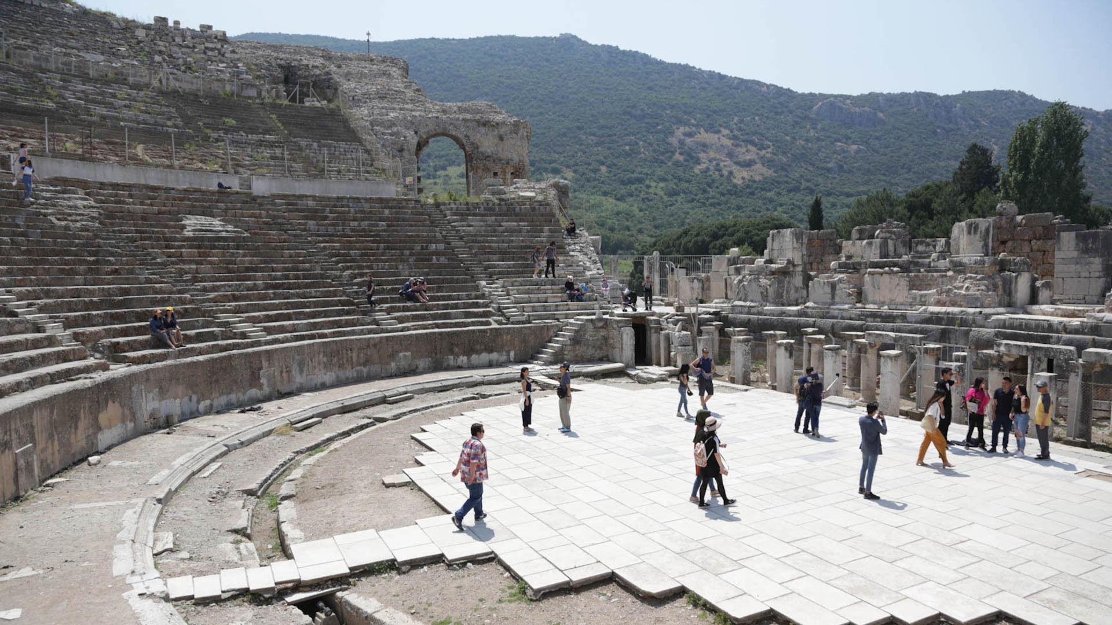
Ephesus – Revelation 2:1-7
The amphitheater where the riot in Acts 19 broke out has also been the venue for rallies and concerts. Sting, Elton John, and Diana Ross are among those who have performed there. Photo by Karrie Sparrow.
Notes:
https://www.imb.org/2018/06/01/what-happened-to-the-seven-churches-of-revelation/
Ephesus-Selçuk
Ephesus was the fourth largest city of the Roman empire in the first century. A thriving commercial center and port city, Ephesus was also the home of a temple to the goddess Artemis. The amphitheater in Ephesus, which could hold up to twenty-five thousand people, was the venue of the angry riot against Christians in Acts 19.
In Revelation, Jesus commended the Ephesian church for enduring hardships and hating the heresy of the Nicolaitans—early Gnostics who wanted to blend Christianity with pagan practices like sexual immorality. But others in Ephesus had fallen from their first love of Christ and received a sober warning: “Repent and do the things you did at first” (Rev. 2:5 NIV). Some scholars think these Christians may have caved to pressure to worship at the cult temple of Emperor Domitian.
The remains of a temple possibly built for Emperor Domitian during the first century. Domitian persecuted the early church and is responsible for exiling the apostle John to Patmos. Photo by Karrie Sparrow.
Over time, Ephesus physically shifted to what is now the small town of Selçuk, only a five-minute drive from the Ephesus ruins. Honeysuckle perfumed the air around the shops and streets I visited. The town is Muslim—as is 99 percent of Turkey. Even so, a small Protestant church of former-Muslim believers gathers in Selçuk for worship and fellowship.

Slide 22
Ephesus – Revelation 2:1-7
Message:
Remember
Repent
Re-do
Notes:
EPHESIANS 3:14-21
For this reason I bow my knees before the Father, from whom every family in heaven and on earth derives its name, that He would grant you, according to the riches of His glory, to be strengthened with power through His Spirit in the inner man, so that Christ may dwell in your hearts through faith; and that you, being rooted and grounded in love, may be able to comprehend with all the saints what is the breadth and length and height and depth, and to know the love of Christ which surpasses knowledge, that you may be filled up to all the fullness of God. Now to Him who is able to do far more abundantly beyond all that we ask or think, according to the power that works within us, to Him be the glory in the church and in Christ Jesus to all generations forever and ever. Amen.
Ephesians 3:14‭-‬21 NASB
https://bible.com/bible/100/eph.3.14-21.NASB

Slide 23
End Here May 27th
Begin Here June 3rd, 2020

Slide 24
Absence of Copyright
This slideshow contains photos, diagrams, and information, some of which were attained through internet searches of public websites. The author of this presentation does not own the copyright on this information, so this slideshow is for personal use only—not for sale or profit. Please utilize it to seek the Lord and grow in your knowledge of His Word and ways.

Slide 25
End Here May 27th
Begin Here June 3rd, 2020

